Slide 1
Controlled Empirical Analysis of Single-Task and Multi Task Learning for Semantic Segmentation and Drivable Area Detection
Advanced Deep Learning Major Project
Nishit Vinod Kumble
Msc. Artificial Intelligence
000804027
Lawrence Technological University

Slide 2
Motivation and Problem Statement
Autonomous driving require multiple perception task
Tasks chosen:
Semantic Segmentation: Classify every pixel.
Drivable Area Detection: Identify safe driving regions.
Traditional Approach: Separate Models (STL)
One model per task
High computation
Inefficientcy in real-time systems
Multi-Task Learning(MTL):
Shared encoder
Multiple task heads
Reduced computation
Shared feature learning
May cause negative transfer
Key Question: Does MTL improve both tasks equally, or do trade-offs emerge?

Slide 3

Dataset & Methodology
BDD100K
10k subset
DATASET SOURCE
2,976
2,380/596
FINAL SAMPLES
TRAIN/VAL SPLIT
512 X 256
19 classes
3 classes
INPUT RESOLUTION
SEGMENTATION
DRIVABLE AREA
All three models are trained on the same 2,976 samples for a fair comparison.

Slide 4
Model Architecture
STL- Seg: Segmentation only
STL-Drive: Drivable Only
MTL-
Shared ResNet-18 encoder
Two Decoder Heads
All models: Adam lr=1e-4 | Batch size=8 | Max 10 epochs | Early stopping (patience=3) | Stopped at epoch 5

Slide 5
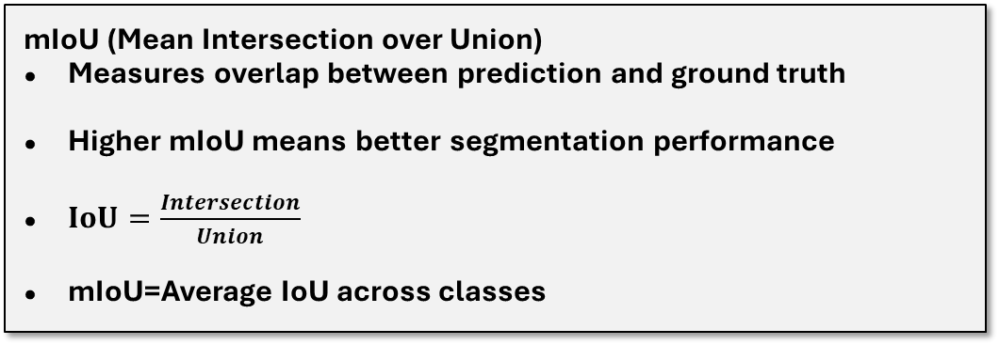
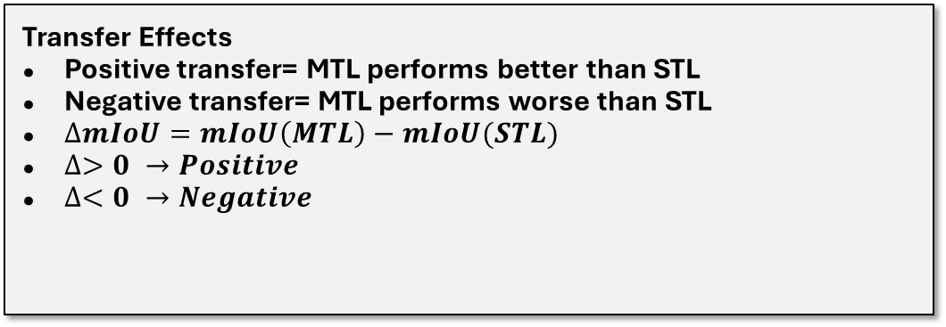
Evaluation Metrics &Transfer Effects
mIoU (Mean Intersection over Union)
Measures overlap between prediction and ground truth
Higher mIoU means better segmentation performance
$IoU=\frac{Intersection}{Union}$
mIoU=Average IoU across classes
Transfer Effects
Positive transfer= MTL performs better than STL
Negative transfer= MTL performs worse than STL
$∆mIoU=mIoU\left(MTL\right)−mIoU(STL)$
$∆>0 →Positive$
$∆<0 →Negative$

Slide 6
RESULTS
Model | Checkpoint | MIoU
STL-Seg | Best(E2) | 0.2814
MTL-Seg | Best(E2) | 0.2945
STL-Seg | Final(E5) | 0.3099
MTL-Seg | Final(E5) | 0.3074
Model | Checkpoint | MIoU
STL-Drive | Best(E2) | 0.6936
MTL-Drive | Best(E2) | 0.6508
STL-Drive | Final(E5) | 0.7189
MTL-Drive | Final(E5) | 0.6740
MTL shows transient early gains in segmentation but consistent negative transfer for drivable area

Slide 7
Transfer Effect Analysis
Task
Checkpoint
STL mIoU
MTL mIoU
Δ / Transfer
Segmentation
Best (E2)
0.2814
0.2945
+1.31pp Positive
Segmentation
Final (E5)
0.3099
0.3074
−0.25pp Negative
Drivable Area
Best (E2)
0.6936
0.6508
−4.28pp Negative
Drivable Area
Final (E5)
0.7189
0.6740
−4.49pp Negative
Segmentation Transfer
Early benefit at epoch 2 (+1.31 pp), but it is temporary.
After convergence at epoch 5, it has -0.25 pp.
Drivable Area Transfer
Consistent negative transfer at both checkpoints.
Harm to drivable task is much larger than any gain in segmentation.

Slide 8
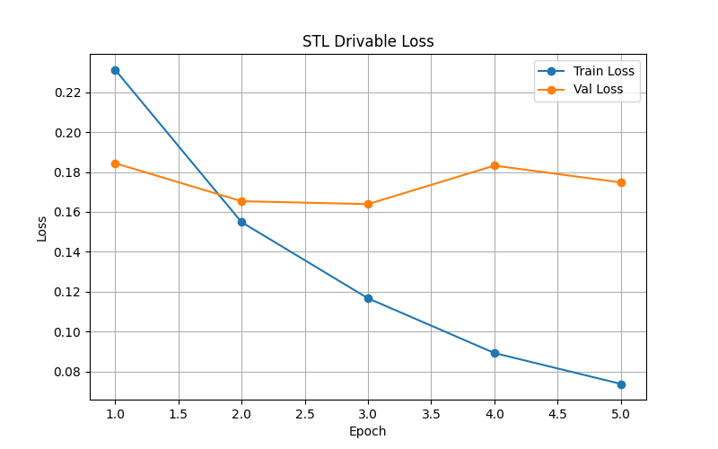
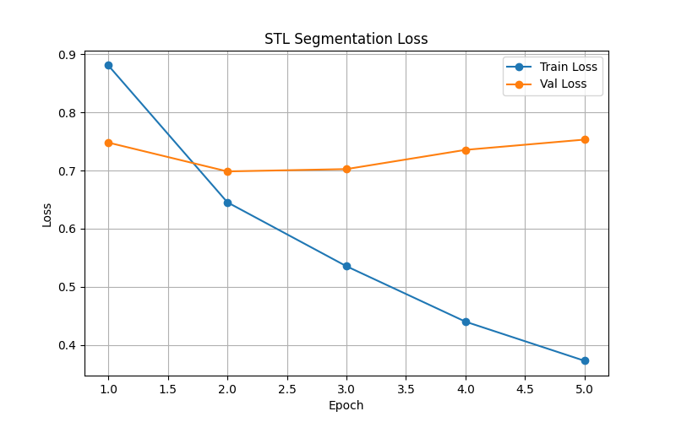
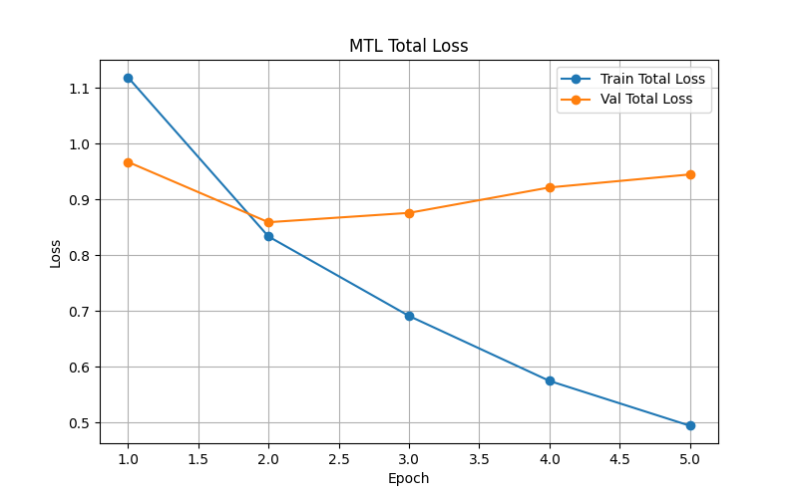
Training Dynamics
All models converge by epoch 2.
Validation loss increases afterward → overfitting begins.
Training loss continues decreasing → model overfits training data.
Early stopping helps control overfitting.
Best performance occurs before full convergence.

Slide 9
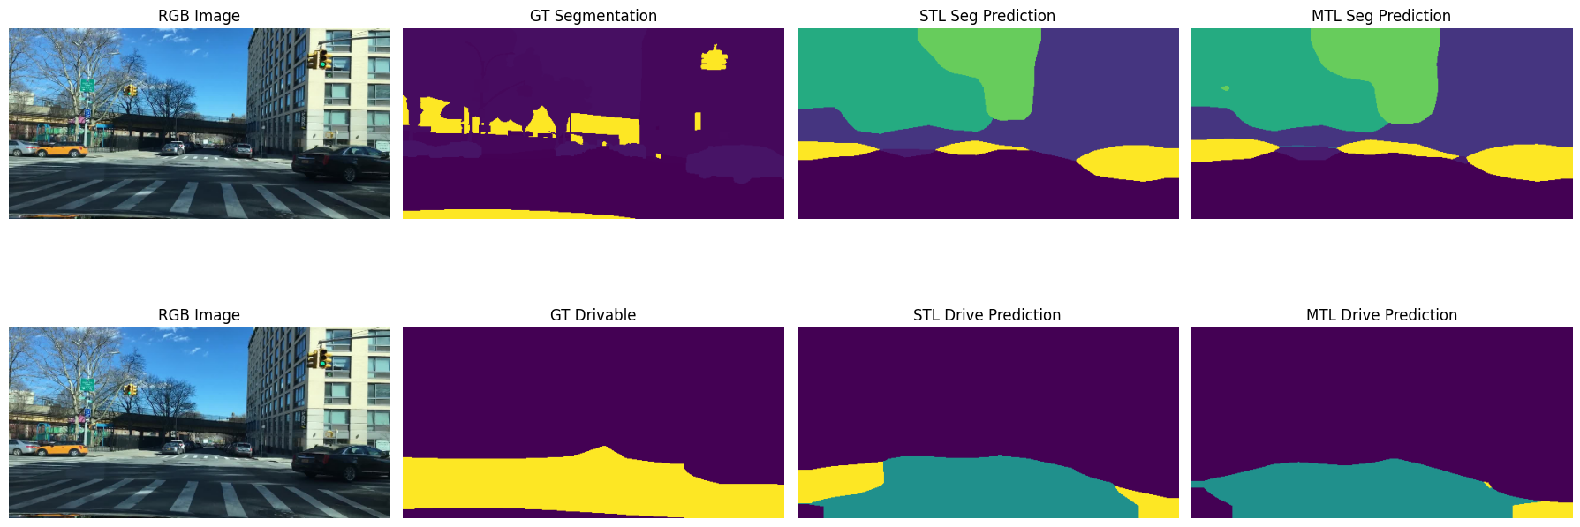
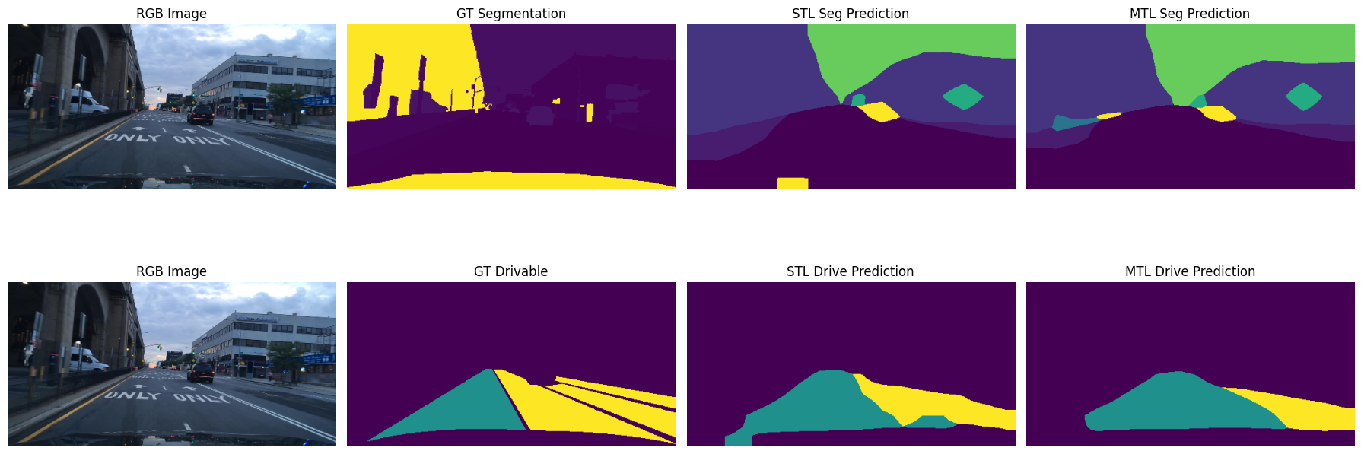
Qualitative Findings
Segmentation:
Both models agree on large regions (road, sky, buildings). Differences are subtle.
MTL shows slightly cleaner mid-image boundaries in complex scenes.
Drivable Area:
STL better separates directly drivable (yellow) vs. alternative (teal) regions.
MTL over-segments and blurs the boundary between drivable classes.
Qualitative differences are more pronounced for drivable area — consistent with the −4.28 to −4.49pp quantitative gap

Slide 10

Why Negative Transfer?
Segmentation Task
Shared
ResNet-18
Encoder
Drivable Area Task
→ Large gradients dominate →
19 output classes
Large, complex loss surface
Rich gradient signals
3 output classes
Simpler loss surface
Smaller gradient signals
← Small gradients overwhelmed ←
$L_{Total}=L_{Seg}+L_{Drive}$ (equal 1:1)
Encoder optimized for segmentation output classes and not for easier drivable classification.
Task gradient imbalance is a primary mechanism for negative transfer.
Magnitude asymmetry: Damage to drivable is much larger than benefit to segmentation.

Slide 11
Conclusion & Future Work
KEY FINDINGS
FUTURE WORK
Drivable Area:
Consistent negative transfer at all checkpoints.(-4.28pp to -4.49pp).
Adaptive Loss Weighting:
Uncertainty-based or gradient normalisation to dynamically balance task contributions.
Segmentation:
Early temporary benefit(+1.31pp, E2) but after convergence it is neutral.
Better Encoder Setup:
Using partial sharing or task-gated encoders to accommodate different feature requirement.
Equal Weight Sharing:
Not sufficient when task differs in complexity.
Stronger Architecture:
Using better encoders(EfficientNet, DeepLab) and decoders( U-Net).
MTL effectiveness is highly dependent on task characteristics : equal-weight sharing is insufficient when tasks differ in complexity.

